Slide 1
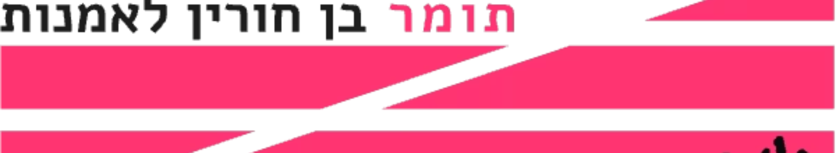
Tomer Ben Horin Art Gallery Management Platform
A comprehensive platform bridging artists, administrators, and art enthusiasts in a modern digital environment.

Slide 2
Overview
We are the group members working on the project for the Tomer Ben Horin Association. They currently have a promoted website where artists can enter their personal information and upload their artworks. The site contains information about the artists, but not the specific pieces they wish to present in an exhibition.
The goal of the project is to create a platform that allows artists to submit the materials they want to display in the exhibition, and also to enable them to edit their personal information on the existing website through our platform..

Slide 3



Team Learning Journey
Initial Challenges
Growth Process
Team Success
Task division and decision-making proved difficult at first.
We developed better listening skills and workflow efficiency.
Quick issue resolution and mutual support became our strengths.
Miscommunication and differing opinions created hurdles.
Each member's unique skills enhanced our final product.
We learned to collaborate effectively despite initial hurdles.

Slide 4
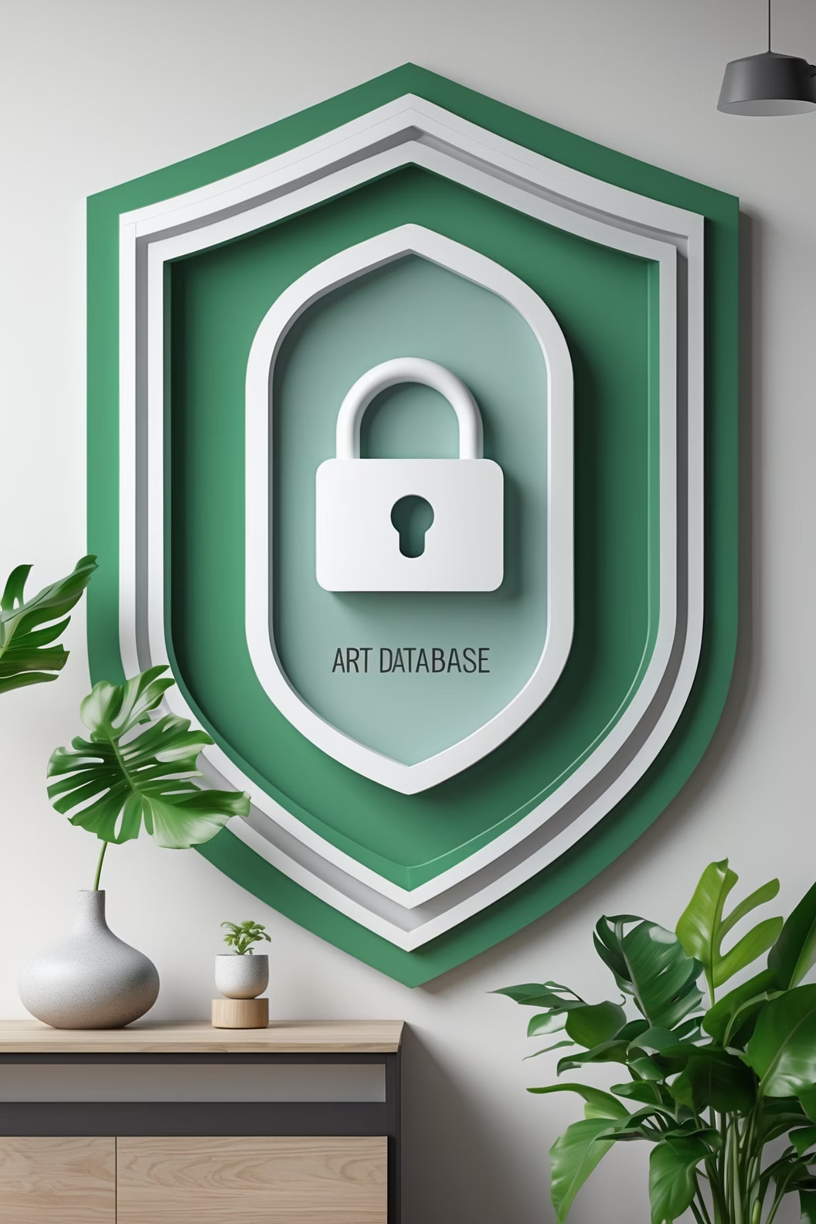
Project Risks
Missing or Incorrect Artwork Data
Artists' artwork information may be incomplete or inaccurate.
Exhibitions could display misleading information.
Artists might not receive proper credit for their work.
Unauthorized Modifications
Weak access controls could allow unauthorized editing.
Important artwork data might be accidentally deleted.
Exhibition integrity could be compromised.

Slide 5
Test Cases
1
Artwork Display Test
View exhibition with missing artwork images.
Expected: Placeholder image appears with correct title and description.
2
Artwork Edit Test
Edit the title and description of an existing artwork and save the changes.
Expected: The updated title and description are displayed correctly in the exhibition view, and no old information remains.

